Slide 1
The Value of Financial Planning
Q4 2018 Playbook

Slide 2
Agenda
Value of a Financial Plan
Naviplan Planning Example
Alignment of Planning and Financial Well-Being
Who do you know?
Q & A

Slide 3
Value of a Financial Plan
Canadians who engage in comprehensive financial planning report significantly higher levels of financial and emotional well-being than those who do no planning or limited planning.
Notes:
The FPSC (Financial Planning Standards Council) conducted a study to determine whether there was value in financial planning. One of the objectives of the study was to measure the impact of financial planning in 3 distinct ways: emotional, tangible, and quantifiable. The results showed that financial planning has a significant impact on each of those 3 measures (as shown in the graph above).
Individuals with comprehensive plans feel their financial goals and retirement plans are more on track; their ability to save has improved in the past five years; and they are more confident they can handle the inevitable bumps in life.
Providing comprehensive discussions and walking our clients through our 6 steps to Financial Peace of Mind, improves the confidence of our members and clients. Those who have gone through financial planning report having higher levels of financial and emotional well being, essentially, an improvement in their financial wellness.

Slide 4
Value of a Financial Plan
Notes:
The study also found that those who have financial plans and cite retirement as an important goal feel more confident in their plans to retire. Those who have financial plans are more likely to report that they have improved their ability to save in the last five years. And those who have comprehensive financial plans are more confident that they are prepared to deal with the challenges and bumps in life, such as unexpected financial emergencies, tough economic times, and ensuring loved ones are financially looked after if something should happen to them.
Individuals who engage in financial planning report higher levels of emotional, financial and overall contentment over those who don’t engage in planning conversations.

Slide 5
Naviplan
Naviplan Example
Notes:
At Thrive we use Naviplan to help client’s organize their goals and set expectations on funding those goals. Through our planning conversations we can understand what is important and why a client’s goals are significant to them.
Segmented planning is offered through the Wealth Advisor and Wealth Specialist channel, and full financial plans via the Wealth Planner role for clients working with Wealth Advisors.
Having a plan in place to reach goals helps our clients feel confident about reaching their goals and improving their overall financial well being.
Let’s walk through a sample naviplan.

Slide 6
Naviplan Example
Notes:
The financial snapshot illustrates a high level overview of the plan we have created for the client. In this example the client’s goal is retirement and we can see at a glance the percentage of the goal the client can achieve, their net worth and cash flows.
* Use real life examples as you walk through the sample plan.

Slide 7
Naviplan Example
Notes:
The Plan Analysis Synopsis is a summary of the details that we have added into this plan. The lifestyle expense shows the monthly income the client would like in her retirement years.

Slide 8
Naviplan Example
Notes:
This page is a continuation of the data that we entered. It details the amounts that are being saved and the accounts that the client will be using to fund the retirement goal.

Slide 9
Naviplan Example
Notes:
The Retirement Goal Coverage details progress towards the retirement goal. Based on this individuals current savings and goals she will be able to cover 82% of her retirement goal. In the proposed plan we have increased her monthly savings to allow the client to reach her retirement goals.

Slide 10
Naviplan Example
Notes:
The retirement cash flow timeline shows the annual inflows and outflows during the retirement period.

Slide 11
Naviplan Example
Notes:
Continuation of the Retirement Cash Flow Timeline. The years in red show when the client will run out of money. The EOY (end of year) assets are often used in estate planning conversations.

Slide 12
Naviplan Example
Notes:
The assets at retirement is where we can see the total assets available to fund the retirement goal, in the year of the client’s retirement, for both the current and proposed plan. It shows both the assets that have been assigned to the retirement goal and those that aren’t.

Slide 13
Naviplan Example
Notes:
The What are my Retirement Goal Options provides alternative ways the client could achieve their goal. In this situation the client could change their annual retirement goal, increase their monthly savings, invest a lump sum today or retire at a later date.

Slide 14
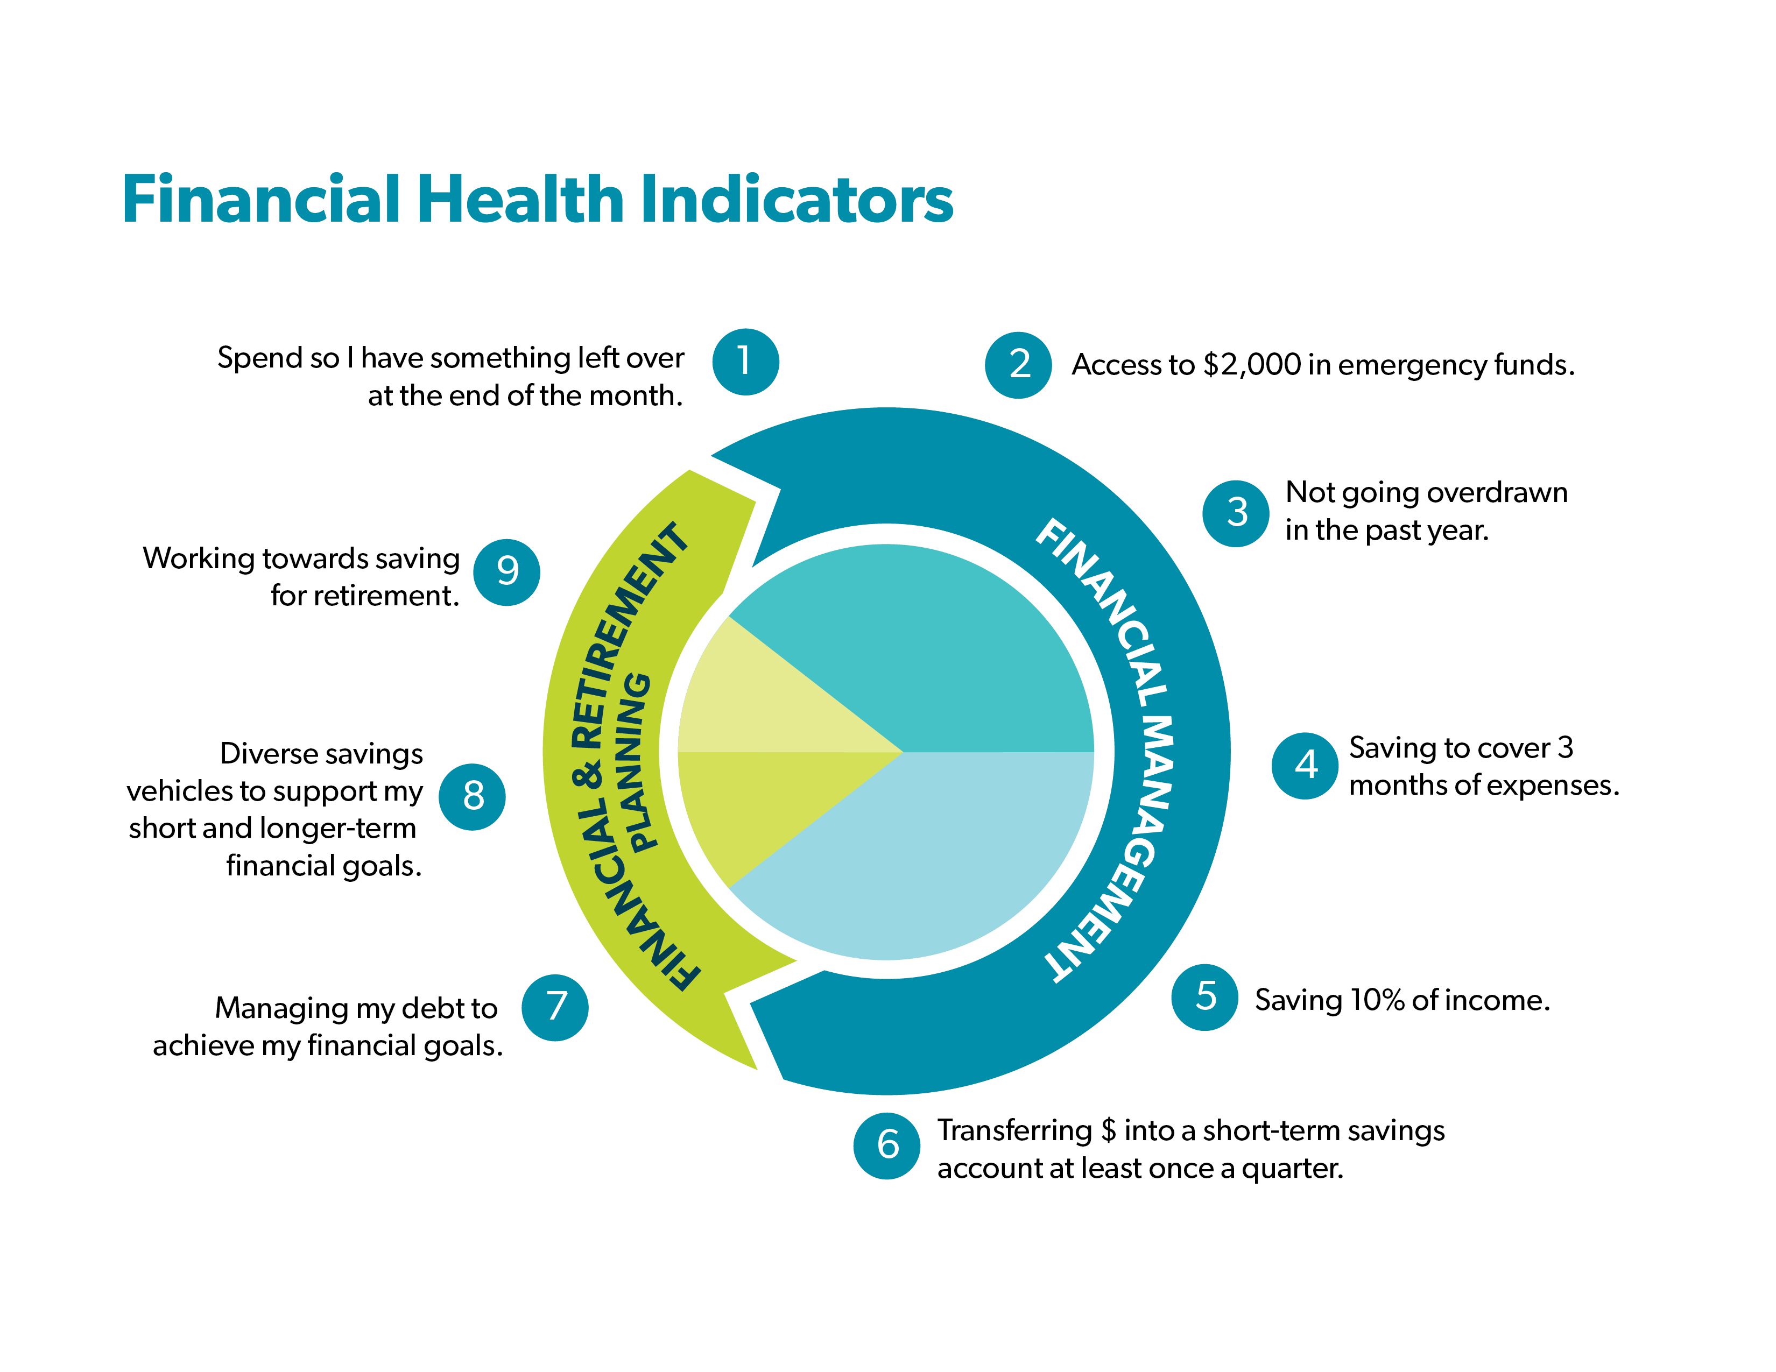
QUESTION
How does Naviplan align with the Conexus Financial Well-Being focus?
9 Driver Connection
Notes:
Ask the participants this question…

Slide 15
The 9 Drivers are the basic behaviours to help members get ahead financially
However they don’t go deep into the details around retirement planning!
Direct connection with Driver 8 and 9!
Great opportunity to refer to our Thrive Partners and improve the FWB of our members
9 Driver Connection
Notes:
Go over the key points above.

Slide 16
Discussion
Who do you know?
Who can we help together?

